Slide 1
Exercise 5

Slide 2
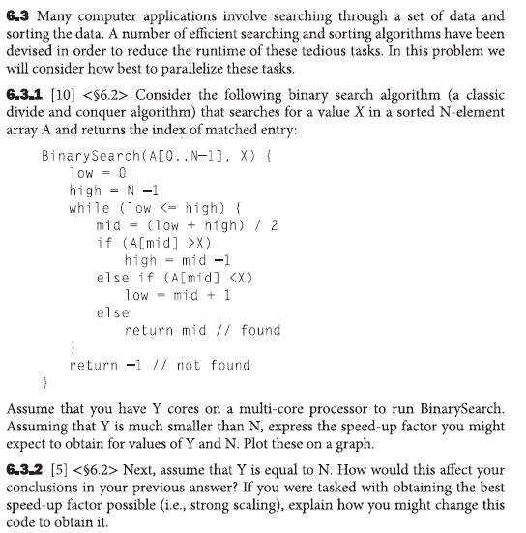

Slide 3
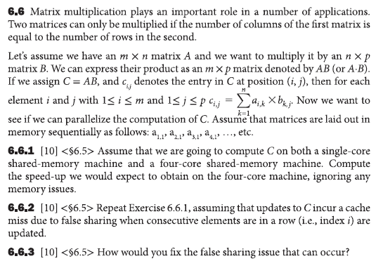

Slide 4
